Slide 1

EU Inductions
Three Pillars
A (mostly) true story of our mission, our values, and the cultural characteristics that shape this organisation

Slide 2
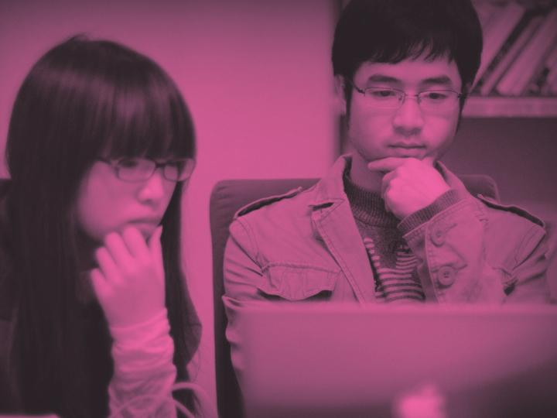
A PRELUDE
Thinking about stories

Slide 3

A GOOD STORY

Slide 4

A HERO
Notes:
has a hero
Roy? or “ThoughtWorkers”?

Slide 5

AN OBJECT OF DESIRE

Slide 6

A SITUATION OF ADVERSITY
Notes:
a situation of adversity
(a villain)

Slide 7

A FAILURE
Notes:
trials to overcome, failures along the way, trough of despair

Slide 8

A SOLUTION
Notes:
often magical

Slide 9

HAPPILY EVER AFTER
Notes:
… and the point is, our story is not like that (real life isn’t really like that)
there isn’t a neat beginning, middle, end
particularly as a PS company, we have a tendency to tell stories
it is how we show our clients we are being successful
“everything sucked - we came along - now it’s all fixed”
but when we are both the client and the provider, our timeframes change a bit - we need to live the ‘happy ever after’ - and discover more about when it isn’t - the nuances become a bit more clear
so when we go through the following, it’s worth bearing in mind:
?? Roy is no hero :)
?? what we’ve chosen as a starting point is somewhat arbitrary
?? the order in which things are presented isn’t necessarily the order in which they occurred
?? quite a lot of the smoothness here is more as a result of after-the-fact rationalisation
?? there was no great adversity to overcome, it is more like a series of adjustments, based on where we were, what we saw, and where that then left us …
?? There are others who will have different interpretations of the same events - their own truths - and it’s worth seeking out their stories of these things too ...
(promise no more glyph abuse)

Slide 10
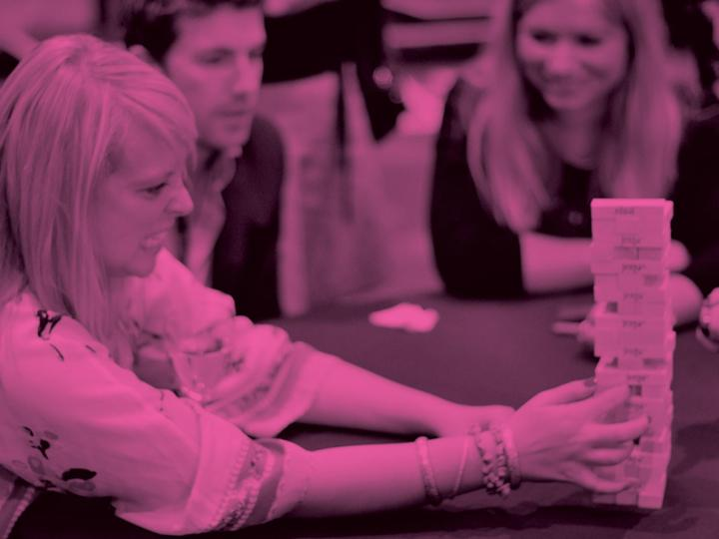
CHAPTER ONE
ThoughtWorks Mission
Notes:
Where would you start the story?
How would you describe what 'there' looked like?
What (major) factors led to it looking like that?
- organic growth as a company
What were the issues we were facing, that led to us looking for a different approach?
Which problems did we tackle first?
first of all (except it wasn’t really first), we started thinking about our purpose (a mission) - and the places where we wanted to focus (some themes)

Slide 11
A 100-YEAR COMPANY
Our mission is to better humanity
through software and help
drive the creation of a socially and economically just world.
Notes:
We are a privately held company. Our founder and majority shareholder has no interest in personal wealth.
Our 100-year mission is to better humanity through software and drive the creation of a socially and economically just world.
That’s pretty big, so we created this 3 pillar model that we use to guide the way we plan, operate and make decisions in the company on a day-to-day basis.
The first pillar is about running a sustainable business. Generating enough revenue, profit and “oxygen” to make sure we’re a dynamic thriving organisation that will be here as a partner to our clients over the long term.
The second pillar is about championing software excellence. Constantly pushing the envelope and advancing the state of the art of software and software practice in the broadest and deepest sense across all dimensions: from technical and operational excellence, through to user experience and optimising business and customer value.
The third pillar is about advocating for social and economic justice. Applying our hearts, minds and resources to improving the lives of the people at the base of the pyramid - who are often invisible, oppressed, powerless and invisible. In practice, this takes all kinds of different shapes: working to improve healthcare in East Africa, helping create awareness of the issues of farmers in rural India, providing a platform to help grassroots communities organise, defending the free internet and working on data privacy issues that are becoming so prevalent in our society.
*

Slide 12
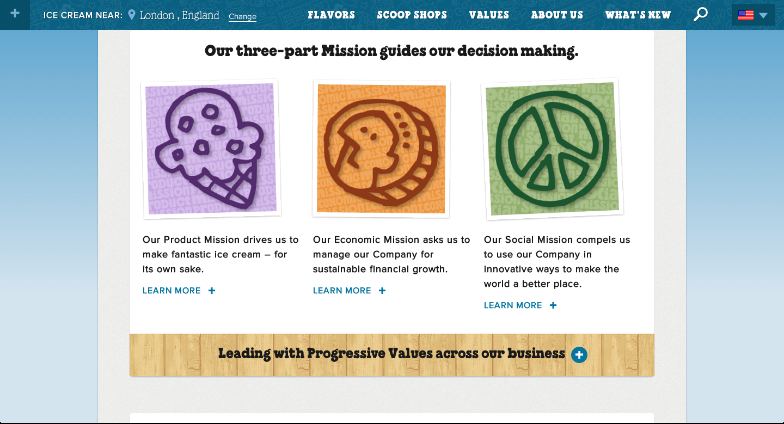

Slide 13



OUR PILLARS
To run a sustainable
business.
To champion software excellence
and revolutionize the IT industry.
To advocate passionately for
social and economic justice.
Notes:
That’s pretty big, so we created this 3 pillar model that we use to guide the way we plan, operate and make decisions in the company on a day-to-day basis.
The first pillar is about running a sustainable business. Generating enough revenue, profit and “oxygen” to make sure we’re a dynamic thriving organisation that will be here as a partner to our clients over the long term.
The second pillar is about championing software excellence. Constantly pushing the envelope and advancing the state of the art of software and software practice in the broadest and deepest sense across all dimensions: from technical and operational excellence, through to user experience and optimising business and customer value.
The third pillar is about advocating for social and economic justice. Applying our hearts, minds and resources to improving the lives of the people at the base of the pyramid - who are often invisible, oppressed, powerless and invisible. In practice, this takes all kinds of different shapes: working to improve healthcare in East Africa, helping create awareness of the issues of farmers in rural India, providing a platform to help grassroots communities organise, defending the free internet and working on data privacy issues that are becoming so prevalent in our society.
*

Slide 14
Values
Customer Committment | Delighting our customers | · Be relentless in our devotion to our customers' success · Be flexible and easy to do business with · Deliver exceptional value to our clients, as defined and measured by them · Have all employees contribute to our customers' satisfaction
Social Responsibility | Building a better world | · Support change in our professions and communities · Oppose inequalities and injustice as individuals and as a company · Actively promote the inclusion of diverse individuals on all teams · Redress historic discrimination, including that of race, gender and sexual orientation
Uncompromising principles | Respect Humility Openness | · Act with respect, integrity and honesty · Act with humility as individuals but with pride as ThoughtWorkers · Insist on transparent and open communication · Bear the cost of doing the right thing · Improve our company for future generations of ThoughtWorkers
Best People | An exceptional community | · Rely on Attitude, Aptitude, Integrity in all our people, valuing talent over experience · Seek out truly excellent people who share our passion and values · Exhibit a can-do attitude and a strong work ethic · Make a disproportionately large impact, both individually and collectively · Learn from internal and external communities about our work, life and world · Create opportunities for individual growth and development, and support that growth
Fun | Have fun Be passionate | · Create a passionate, zestful and committed environment · Encourage initiative, avoid resting on our laurels and playing it safe · Foster a positive and fun environment · Identify, develop and value personal energy and emotional intelligence in our leaders
Entrepreneurialism | Imagine and pursue | · Be fearless, courageous, open-minded, self-motivated and eager to learn · Accept risks intelligently, viewing them as a positive feature of our business · Make mistakes fast and learn from them · Stretch our people and support them if they fail · Act with an entrepreneurial spirit, with each employee acting as owner
Global | Transnational Team | · Drive global success while ensuring the sustainability of local business · Provide our people opportunities to experience and work in different countries · Bring transnational representation to all of our offices and teams · Foster a global company culture built on an awareness of local cultures
*

Slide 15
OUR CULTURE
Do the Right Thing
Service to others and Society over Self
Attitude, Aptitude, Integrity
Solidarity over Charity
Holistic Goals over Targets
Personal and Organisational Transparency
Curiosity, Creativity & Passion
Fail Fast & Publish our Mistakes
Intolerant of Intolerance
No Jerks
High Values Alignment, Loosely Coupled
*
Notes:
*

Slide 16

Notes:
https://en.wikipedia.org/wiki/The_No_Asshole_Rule
The theme of this book is that bullying behaviour in the workplace worsens morale and productivity. A rule is suggested to screen out the toxic staff—the no asshole rule. The author insists upon use of the word asshole since other words such as bully or jerk do not have the same impact.^{[4]}
"There's an emotional reaction to a dirty title. You have a choice between being offensive and being ignored."
—Robert Sutton
Two tests are specified for recognition of the asshole:^{[5]}
After encountering the person, do people feel oppressed, humiliated or otherwise worse about themselves?
Does the person target people who are less powerful than him/her?
Their unpleasant behaviours were catalogued by Sutton as The Dirty Dozen:^{[6]}
Insults
Violation of personal space
Unsolicited touching
Threats
Sarcasm
Flames
Humiliation
Shaming
Interruption
Backbiting
Glaring
Snubbing

Slide 17
OUR FOCUS
Amplifying our impact:
Re-defining the role of technologists in society
*
Notes:
Big 100 year mission. What are the steps that need to happen to get there over the next 2-3 years?
Need to have more impact in society and understand the playing field to make a change
If our 100-year mission is “to better humanity through software”, we are going to start with the people who can arguably have the greatest effect on that - the technologists
- Achieving our mission will not be possible with just TW the 3,000-person company (or even the 10,000-person company). It requires an ecosystem - if we can get the technologists on board (the people we know the best and have the best chance of influencing - and also some of the potentially most powerful people of this century) we can really amplify our impact
How are we going to do it? (the vision). We need to amplify our voice and the strategies will help. We want to be the ones showing the way. Gifted technologists that don’t want to just work for personal development and wealth but help shape and give back to society. With IT growing more critical to an increasingly complex and integrated world, the power and influence of skilled technologists continues to grow.
`
Chris blog nicely explains: https://my.thoughtworks.com/blogs/chrismurphy/2013/02/27/amplifying-our-impact-redefining-the-role-of-technologists-in-society
Trevor at US Away Day in 2012? 2013?
Quoted Jeff Hammerbacher - who said (on quitting Facebook):
"The best minds of my generation are thinking about how to make people click ads," he says. "That sucks."
Our ‘focus’ is our way of coming up with an answer for that.
http://www.businessweek.com/magazine/content/11_17/b4225060960537.htm
*

Slide 18
THANKS
To find out more - check out:
https://my.thoughtworks.com/groups/strategic-themes

